Slide 1
ANIMAL NUTRITION
Practical – spotting

Slide 2
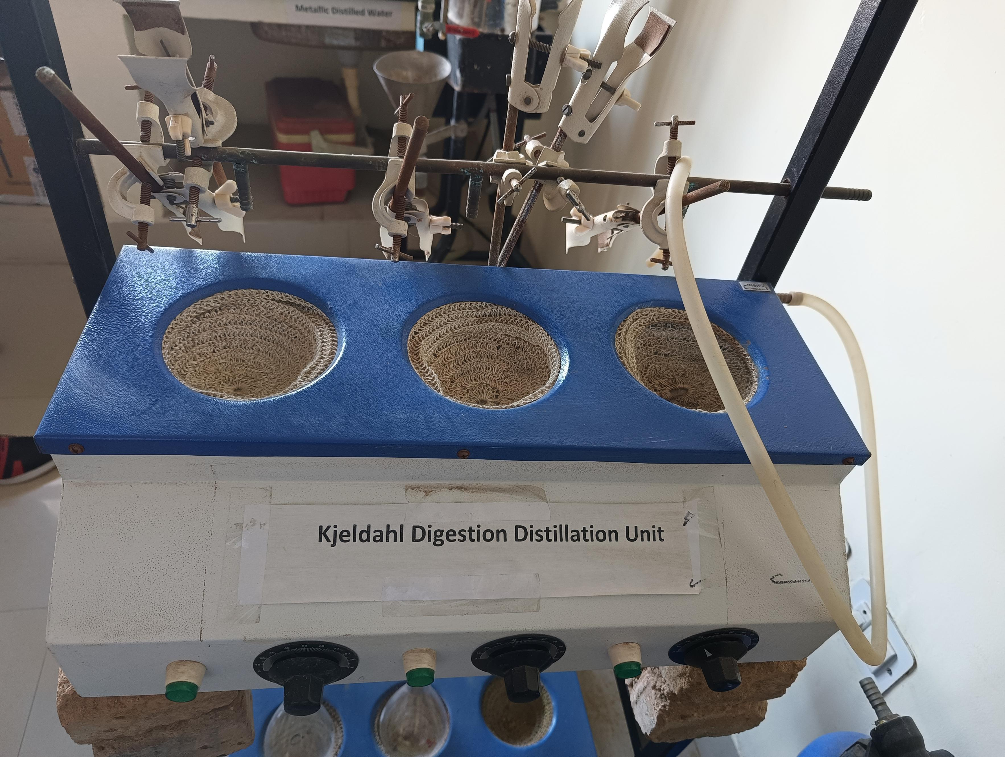
Determine the protein, nitrogen and ammonia content

Slide 3
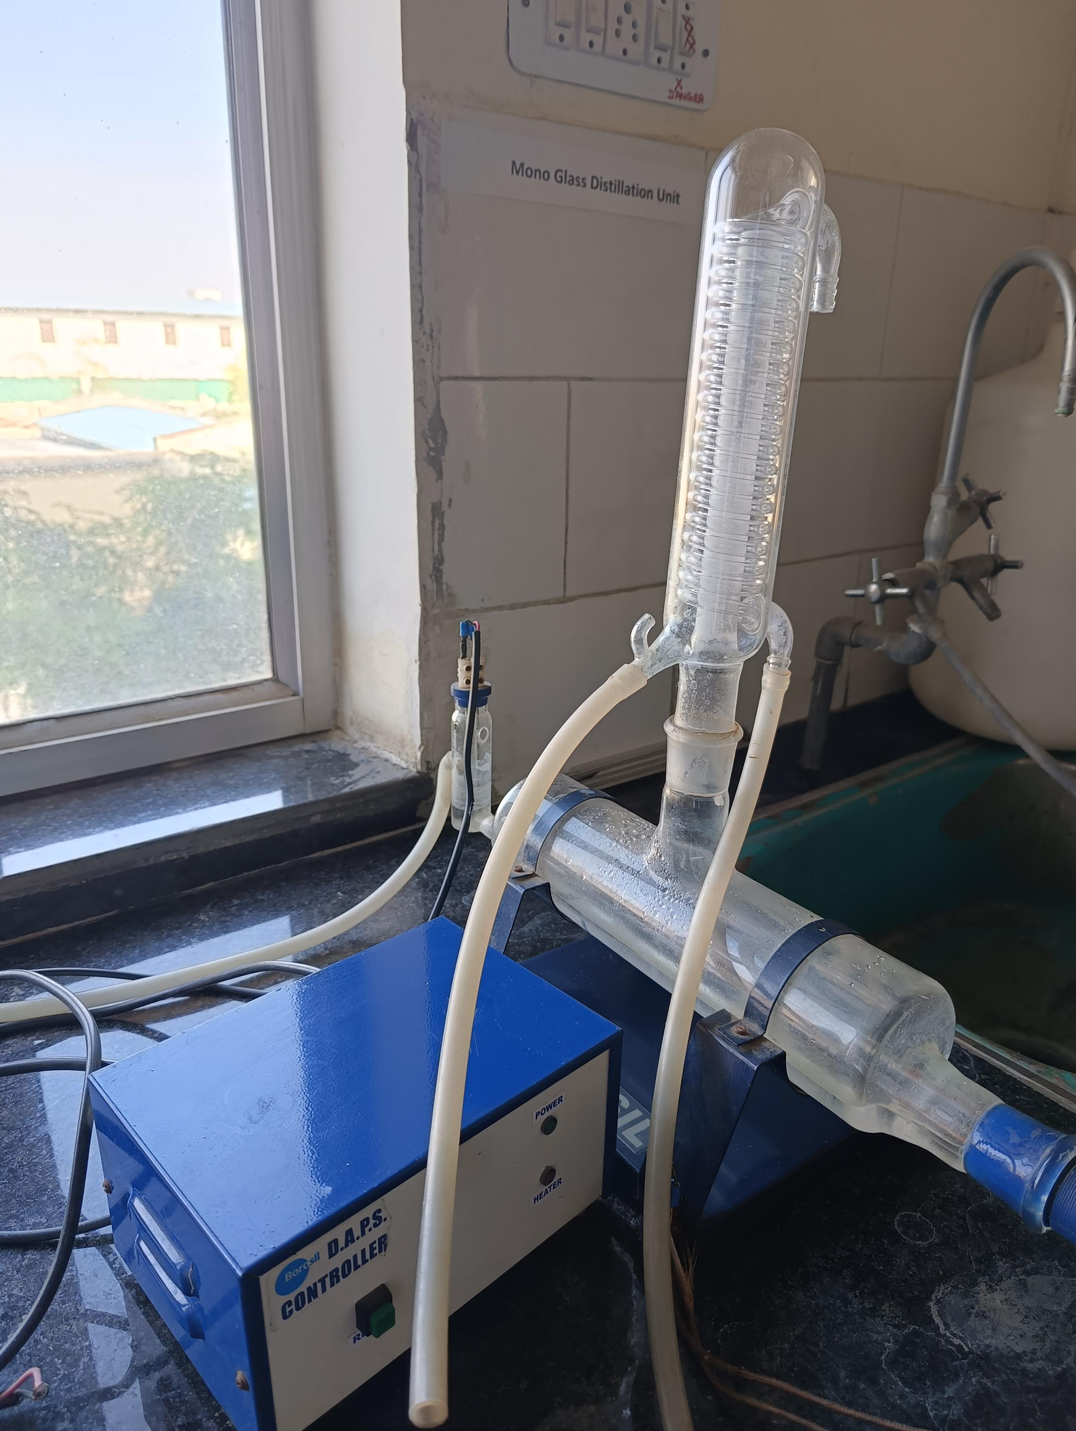
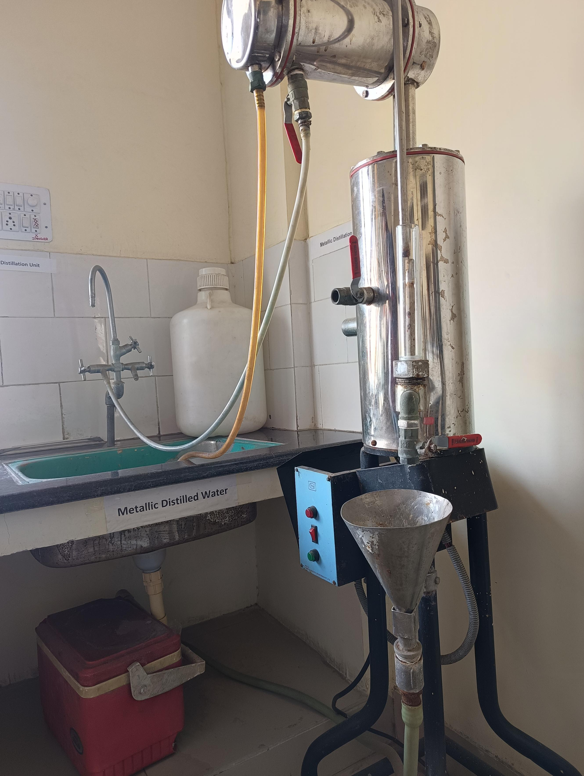
Metallic distill water &Monoglass distillation unit Healthy adults who eat a balanced diet can drink distilled water if they prefer this method of water purification.

Slide 4
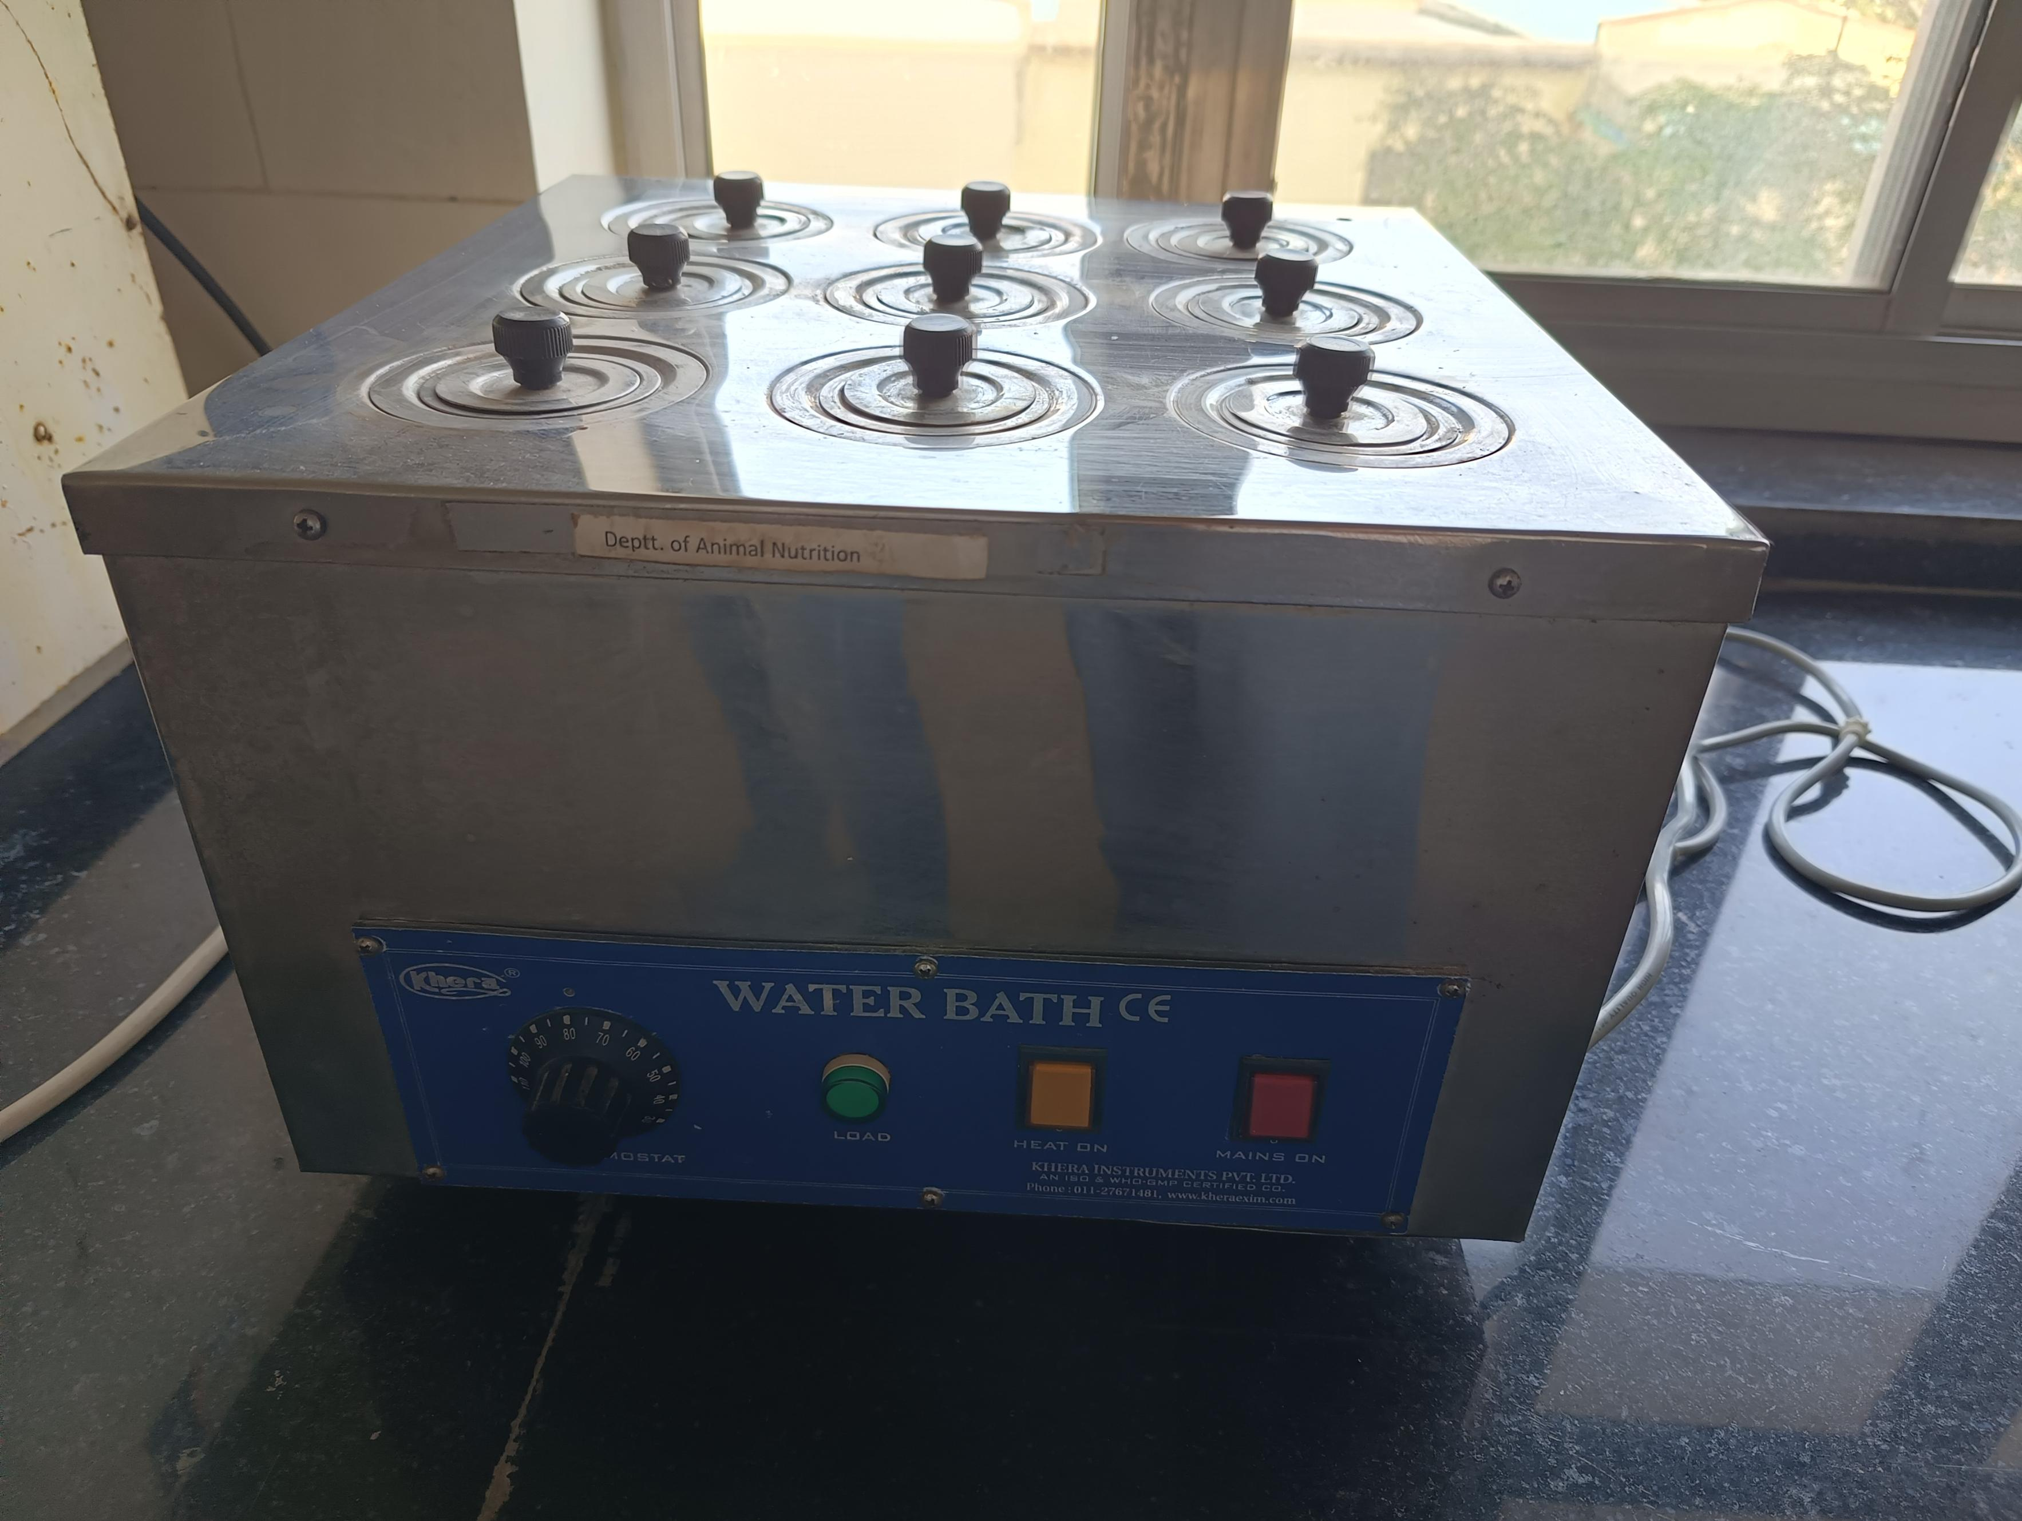
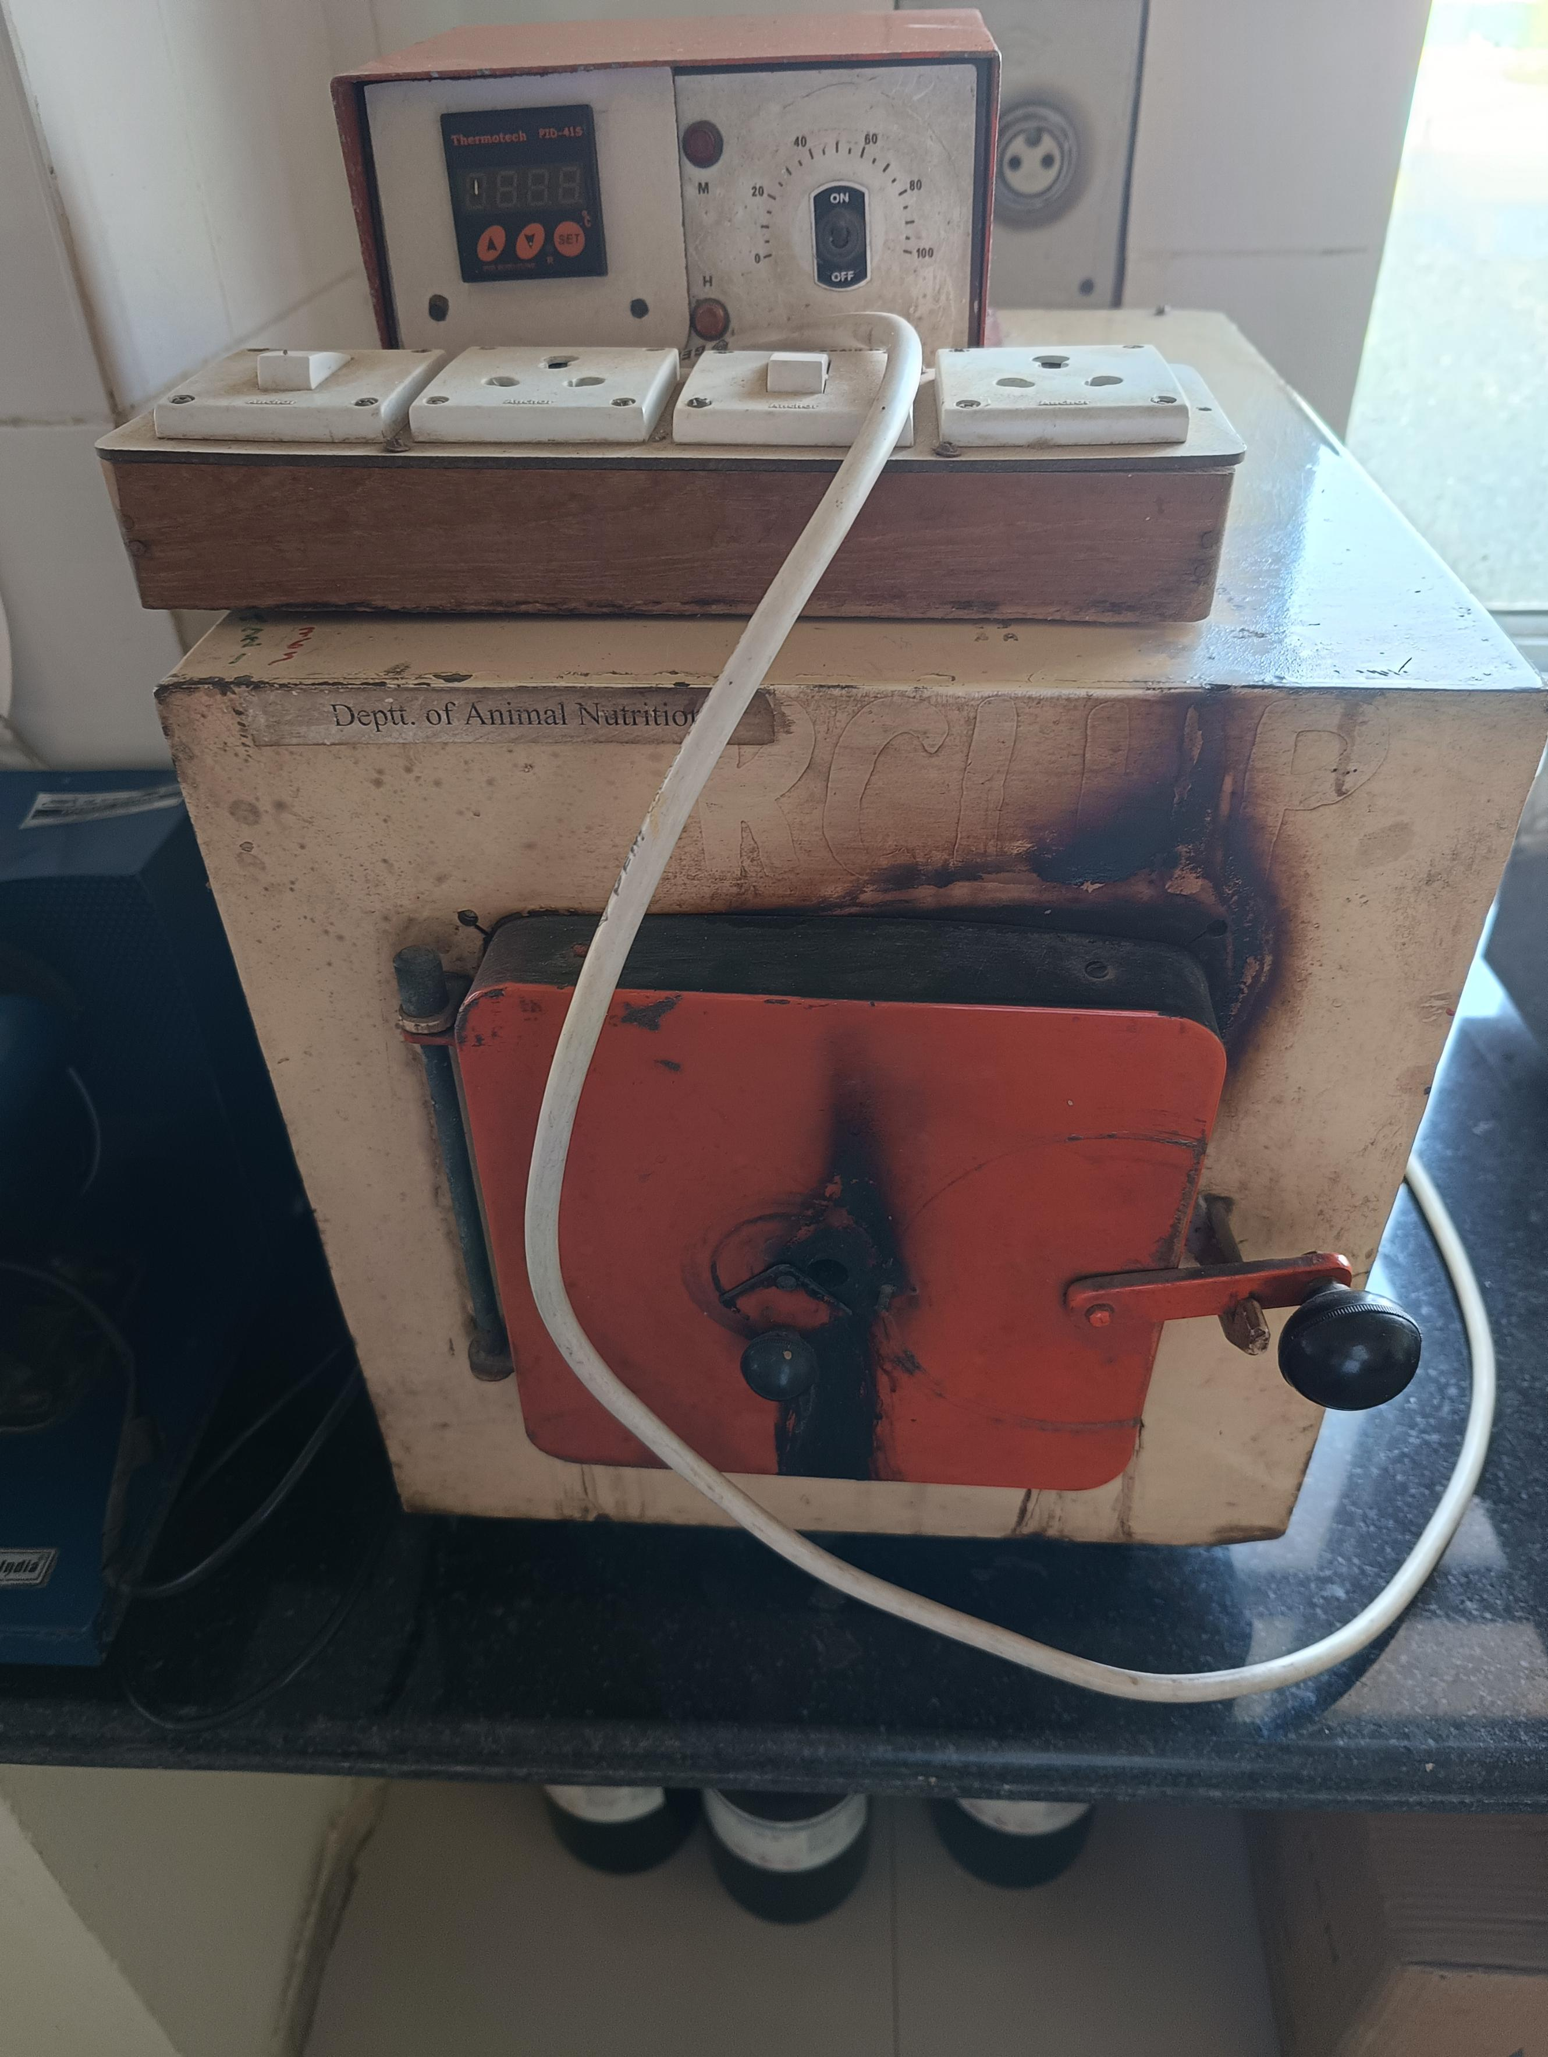
Waterce ath & muffle Furnabc--A water bath is used to incubate samples at a constant temperature over a long period of time.2Ashing samples

Slide 5
